Slide 1


Credit Risk & Loan Default Prediction
NCPS730 Capstone · 2026
CAPSTONE PROJECT · FINAL PRESENTATION
CREDIT RISK AND LOAN DEFAULT PREDICTION
A comparative machine learning and explainable AI approach
Aphelele Siphelele Gwebityala
Student No. 202430482
BSc Data Science · Sol Plaatje University · 2026
Supervisor: Mrs Nthabiseng Modiba

Slide 2
Credit Risk & Loan Default Prediction
NCPS730 Capstone · 2026
THE PROBLEM AND OBJECTIVES
Every loan is a bet on repayment. Wrong bets are costly in both directions.
R27.1bn
255,347
11.6%
bad debt charges, SA big four banks, H1 2024 (PwC, 2025)
loan records in the dataset
of loans default (imbalanced data)
Problem statement
Objectives
Credit institutions face a high-stakes decision: they must determine whether an applicant is likely to repay a loan before providing the funds.
Loan default prediction is challenging because risk is not determined by one factor. Applicant income, employment, interest rate, age, debt-to-income can interact in complex ways
A model cannot be useful in credit decisions if it only predicts risk without explaining it. The system therefore needs to produce reliable probabilities and understandable reasons for its predictions
Reach test AUC ≥ 0.75
Produce well-calibrated probabilities of default
Explain every prediction (SHAP, odds ratios, scorecard)
Deliver an interactive dashboard
Notes:
Every time a bank approves a loan, it is making a bet that the person will pay it back. If the bet is wrong, the bank loses money.
But it can also go wrong the other way: if a bank refuses someone who would have repaid, it loses a customer and that person loses access to credit and thus both errors are costly
This matters in South Africa.
According to PwC, the four biggest banks recorded R27.1 billion in bad debt charges in the first half of 2024 alone.
My dataset is the Kaggle Loan Default dataset with 255,347 loans with only 11.6% of them ending in defaulte so it is imbalanced, and that becomes important later so keep it in mind
My problem statement has three parts:
1.Predict default using only information known at application time
2.Do it without distorting the probabilities or the statistics, since class imbalance techniques like SMOTE can do that exactly
3.Make every decisions explainable, because the National Credit Act expects lenders to justify decisions.
My objectives follow directly from that:
1.I should atleast reach an AUC of at least 0.75
2. Again produce trustworthy, well calibrated probabilities
3. I should again explain every prediction
4. And deliver a working dashboard.

Slide 3
Credit Risk & Loan Default Prediction
NCPS730 Capstone · 2026
SCOPE AND DELIMITATION
What this study covers, and what it deliberately leaves out
In scope
Out of scope
One public dataset: Kaggle Loan Default (255,347 loans)
Logistic + L1, Probit, Random Forest, XGBoost
Weight-of-Evidence points scorecard (optbinning)
Explainability: SHAP, odds ratios, Information Value
A Streamlit dashboard and a Power BI dashboard
Deep learning beyond a simple network
Other data (bank transactions, social media, telecoms)
A production, live banking system: the app is a research prototype
A full fairness and bias audit (flagged as future work)

Slide 4
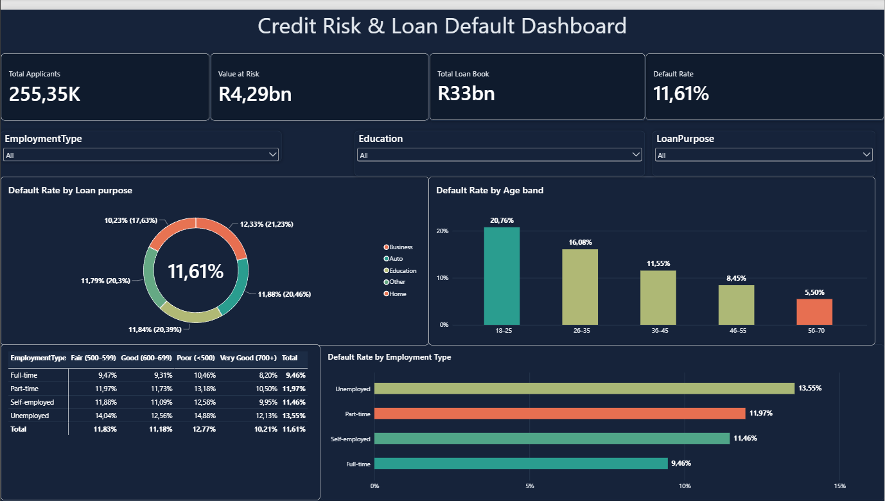
Credit Risk & Loan Default Prediction
NCPS730 Capstone · 2026
PowerBI Dashboard
Power BI for portfolio insight
Power BI: portfolio view (255K loans, R33bn book, R4.29bn at risk)

Slide 5
Credit Risk & Loan Default Prediction
NCPS730 Capstone · 2026
RELATED LITERATURE AND THE GAP
18 studies reviewed (Chapter 2): three consistent threads
Ensembles win, but need explaining
Random Forest and XGBoost beat linear models on tabular credit data, and are paired with SHAP (Chang et al., 2024; Martin et al., 2024; Lundberg & Lee, 2017).
1
Imbalance is under-addressed
Accuracy hides poor recall on defaulters; there is no single fix (Zurada, 2002; Zhou & Wang, 2012; He & Garcia, 2009).
2
Interest rate and risk are linked
South African and microfinance work agrees interest rate is both a result and a cause of default risk (PwC, 2025; Stiglitz & Weiss, 1981).
3
Gap this project fills: few studies show a failed calibration test and how it was fixed, or test SMOTE against class-weighting on the same data.

Slide 6
Credit Risk & Loan Default Prediction
NCPS730 Capstone · 2026
METHODOLOGY: CRISP-DM PROCESS FLOW
Six phases, applied end to end, with one important correction along the way
Business understanding
Data understanding
Data preparation
Modelling
Evaluation
Deployment
Goal: PD + explanation
EDA, chi-square, correlations
One-hot, 80/20 split, class weights
Logit, RF, XGBoost, scorecard
AUC, recall, calibration
Streamlit + Power BI
Key methodological correction
Earlier version used SMOTE: Hosmer-Lemeshow test failed and every p-value was exactly zero
Final version uses class weights (class_weight='balanced', scale_pos_weight) on the real data distribution
Result: valid inference, honest comparison and calibratable probabilities

Slide 7
Credit Risk & Loan Default Prediction
NCPS730 Capstone · 2026
IMPLEMENTATION PIPELINE AND TOOLS
From raw loan records to a deployed, explainable scoring tool
1
Raw data
2
Clean and encode
3
Split
4
Train and tune
›
›
›
Kaggle Loan Default: 255,347 loans, 16 predictors, 11.6% default
No missing values or duplicates; LoanID dropped; one-hot encoding gives 24 columns
Stratified 80/20: 204,277 train and 51,070 test loans
Class-weighted Logistic + L1, Random Forest and XGBoost, tuned with 5-fold CV
5
Evaluate
6
Calibrate
7
Explain
8
Deploy
›
›
›
AUC, recall, precision, F1; Youden's J threshold
Isotonic calibration; Hosmer-Lemeshow test (p = 0.21)
SHAP, odds ratios, Information Value and WoE scorecard
Streamlit app (live scoring) and Power BI dashboard
Tools: Python, pandas, scikit-learn, XGBoost, statsmodels, SHAP, optbinning, matplotlib, Streamlit and Power BI

Slide 8
Credit Risk & Loan Default Prediction
NCPS730 Capstone · 2026
DATA AND FINAL MODEL DATA
255,347 loans, 16 predictors, 24 model columns after encoding
1
9 numeric features
Age, Income, LoanAmount, CreditScore, MonthsEmployed, NumCreditLines, InterestRate, LoanTerm, DTIRatio
2
7 categorical features
Education, EmploymentType, MaritalStatus, HasMortgage, HasDependents, LoanPurpose, HasCoSigner (one-hot encoded, 24 model columns)
3
Clean data
No missing values, no duplicates. LoanID dropped.
4
Split and imbalance
Stratified 80/20: 204,277 train, 51,070 test. Class weights, no SMOTE.
Class balance

Slide 9
Credit Risk & Loan Default Prediction
NCPS730 Capstone · 2026
FEATURE SELECTION: INFORMATION VALUE
IV measures how well a variable separates defaulters from non-defaulters
How to read it
Above 0.1: medium (Age, InterestRate, Income)
0.02 to 0.1: weak
Below 0.02: useless
CreditScore IV = 0.013: almost no independent signal
The 3 methods (IV, odds ratios, SHAP) agree on the top drivers

Slide 10
Credit Risk & Loan Default Prediction
NCPS730 Capstone · 2026
MODEL PERFORMANCE (TEST SET, THRESHOLD 0.5)
After fair class-weighting, the three models are almost equal
0.759
XGBoost test AUC (CV 0.753 ± 0.003)
0.756
scorecard AUC: transparent, nearly equal
Earlier XGBoost advantage was a SMOTE artefact, not real model superiority.

Slide 11
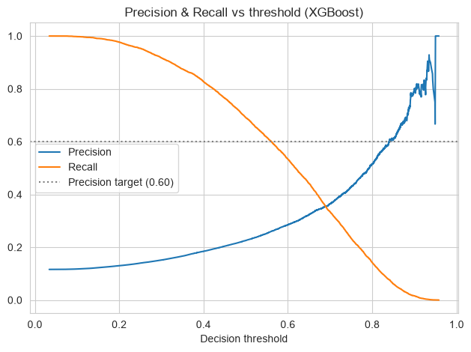
Credit Risk & Loan Default Prediction
NCPS730 Capstone · 2026
THE PRECISION-RECALL TRADE-OFF
Why the 0.60 precision target could not be met
0.840
0.077
threshold needed for 60% precision
recall at that threshold
Youden's J threshold
Optimal cut-off 0.508, almost the default 0.5
TPR 0.68, FPR 0.30, F1 0.344
So 0.5 is already near optimal
Chosen policy favours catching defaulters

Slide 12
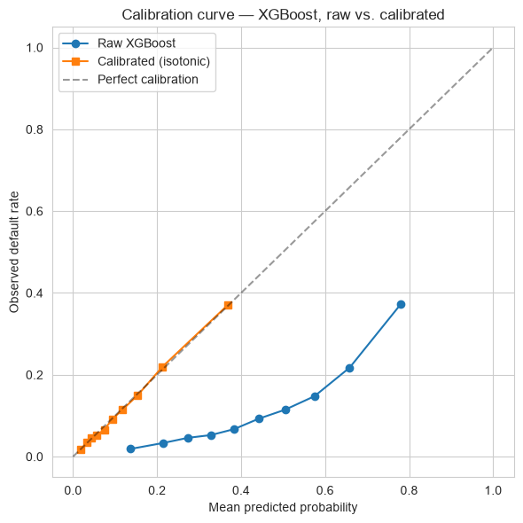
Credit Risk & Loan Default Prediction
NCPS730 Capstone · 2026
CALIBRATION: MAKING PROBABILITIES TRUSTWORTHY
Isotonic calibration on XGBoost, tested with Hosmer-Lemeshow
p < 0.0001
p = 0.21
raw XGBoost (stat 25,643): fails
calibrated (stat 10.9): passes
Tree models over-state risk when trained with class weights
Calibration reshapes probabilities only: AUC 0.7583 to 0.7588
A predicted 30% now means about 30% observed
SHAP is computed on the raw model; calibration is monotonic so driver rankings are unchanged

Slide 13
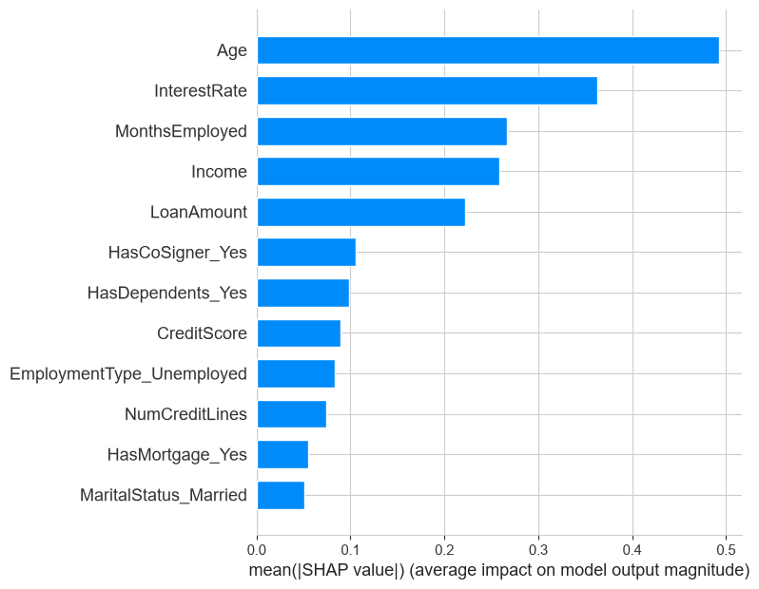
Credit Risk & Loan Default Prediction
NCPS730 Capstone · 2026
EXPLAINABILITY WITH SHAP
Which features drive each prediction, and in which direction
What it tells a credit officer
Top 5 drivers: Age, InterestRate, MonthsEmployed, Income, LoanAmount
CreditScore ranks only 8th
Odds ratios: +1 SD interest rate = 1.58x odds of default; +1 SD age = 0.56x
The dashboard shows a per-applicant waterfall

Slide 14
Credit Risk & Loan Default Prediction
NCPS730 Capstone · 2026
FROM PROBABILITY TO DECISION: RISK BANDS
Calibrated PD split into three tiers that separate risk cleanly
74.4% of applicants
Approve on standard terms
LOW
22.8% of applicants
Review: higher rate, co-signer or lower amount
MEDIUM
2.9% of applicants
Decline or manual underwriting
HIGH

Slide 15
Credit Risk & Loan Default Prediction
NCPS730 Capstone · 2026
ACTIONABLE INSIGHTS AND LIMITATIONS
What a lender should do, and what this study cannot claim
Recommendations
Limitations and future work
Use class weights, not SMOTE, and always test calibration
Use the scorecard as the regulator-facing tool; XGBoost + SHAP for monitoring
Send medium and high bands to human review
Price young, low-income and short-tenure applicants with care
Test the CreditScore finding on another dataset; next steps: fairness audit, drift monitoring
One static public dataset: no test of concept drift over time
Model settings searched on a 40,000-row subsample of training data
How CreditScore was generated is undocumented, so its weak signal is an open question
No fairness audit (Age is a strong driver); precision about 0.23; prototype only

Slide 16
Credit Risk & Loan Default Prediction
NCPS730 Capstone · 2026
CONCLUSIONS
Accurate enough
Test AUC 0.759 meets the 0.75 objective
Honest probabilities
Calibration fixed: H-L p 0.21
Explainable
SHAP + scorecard (AUC 0.756) at no real accuracy cost
Method matters
Class weights beat SMOTE for valid inference
Code repository: [add GitHub link here]
Thank you

Slide 17
Credit Risk & Loan Default Prediction
NCPS730 Capstone · 2026
LIVE DEMO
Streamlit application and Power BI dashboard
Streamlit app (8 tabs)
Full analysis: EDA, models, IV, calibration, SHAP
Live applicant form
Probability of default, risk band, recommendation
SHAP waterfall per applicant
Runs with: streamlit run app.py

